Slide 1
Exploring Libraries and Approaches for Project Enhancement
“CleanLab”

Slide 2
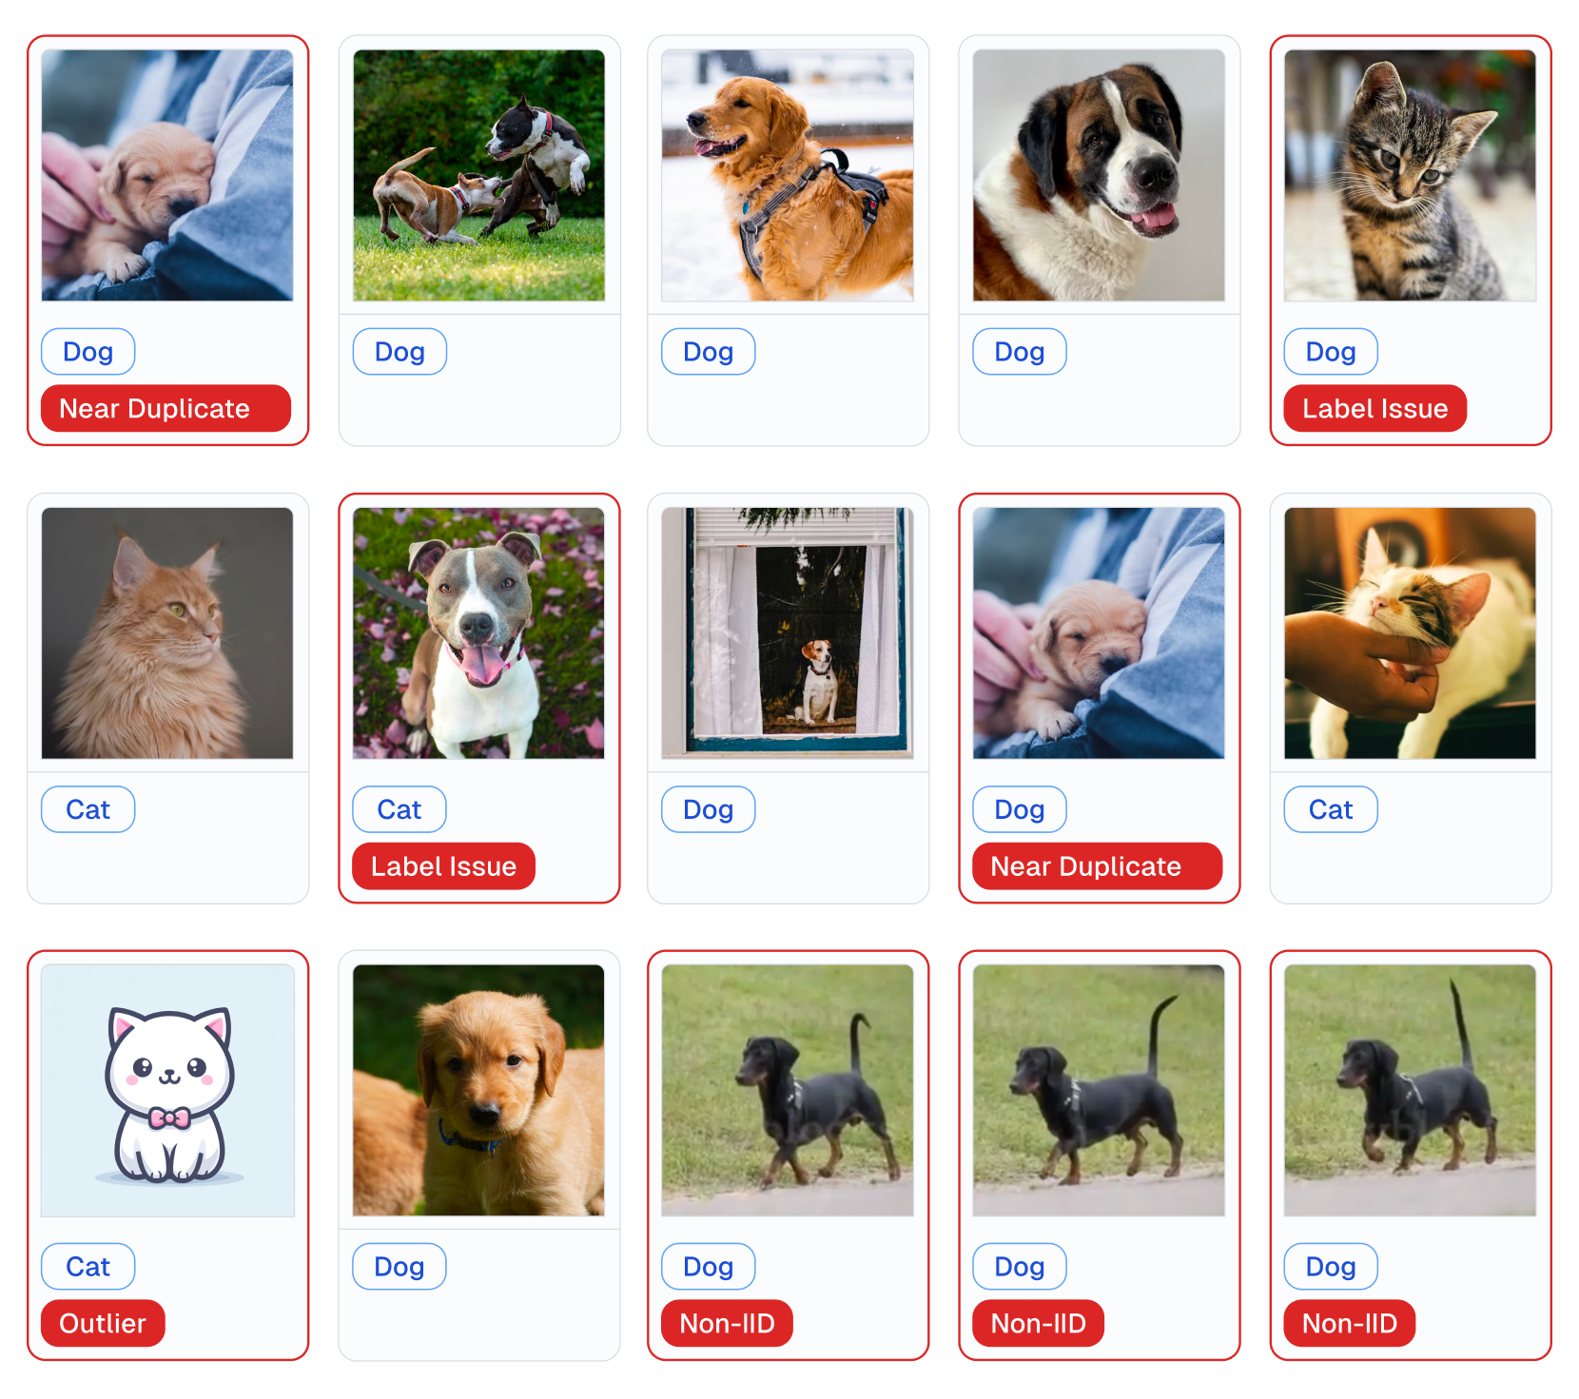

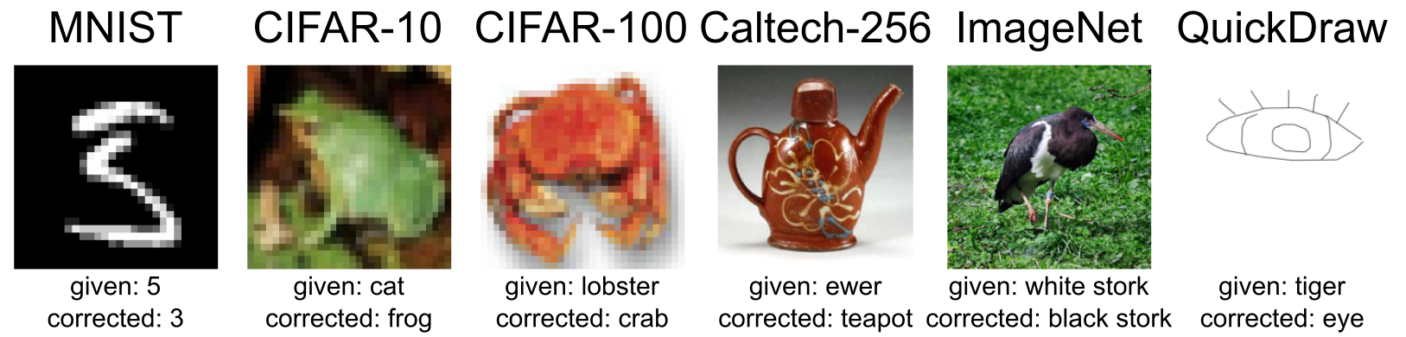
Notes:
cleanlab is a comprehensive tool that aids in the cleaning of data and labels by automatically detecting issues within an ML dataset. Tailored to streamline machine learning processes with real-world, often messy data, this data-centric AI package leverages your existing models to pinpoint and rectify dataset problems. By doing so, it enhances the training process, ultimately leading to the development of more effective models.
With cleanlab, users can easily identify data and label issues, empowering them to train reliable ML models. Additionally, cleanlab employs state-of-the-art confident learning algorithms to enhance the quality of your data's labels, ensuring more accurate and robust model training.

Slide 3
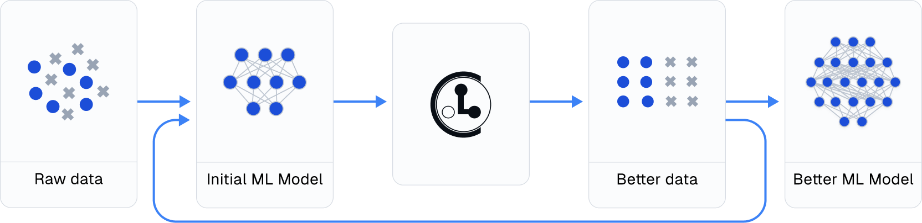
RUN CLEANLAB : Data-Centric AI Practice
Train initial ML model.
Use cleanlab for data diagnosis and improvement.
Retrain model on enhanced dataset.
Experiment with different techniques.
Insight: Significant gains possible through cleanlab.
Recommendation: Iterate Steps 2 → 4 for continuous improvement.
Notes:
Alright, let's delve into how the cleanlab library works in practice. Here's a breakdown of the steps:
Firstly, we start by training our initial machine learning model on our original dataset. This is our baseline.
Then comes the interesting part. We leverage cleanlab methods to diagnose any issues within our data. It's like a detective for our dataset, helping us uncover labeling errors, mislabeled data points, or even instances of ambiguous labeling.
Once we've identified these issues, we roll up our sleeves and improve our dataset based on these findings. This could involve correcting mislabels or removing ambiguous instances.
Now, armed with a cleaner dataset, we retrain our model. This time, it's on the enhanced dataset, potentially leading to better performance without changing a single line of our modeling code.
But we don't stop there. We should experiment with various modeling techniques, pushing the boundaries of performance even further.
Here's the kicker: many practitioners typically focus solely on steps one through four. However, the real magic happens when we continuously iterate through steps two to four. That's where cleanlab shines.
So, in essence, cleanlab enables us to continuously boost performance by diagnosing and improving our data iteratively. It's like having a data-quality assistant on hand, ensuring our models perform at their best.

Slide 4
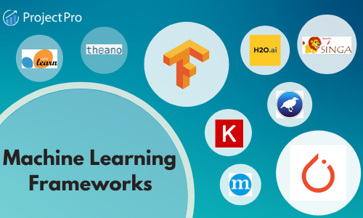
cleanlab: Versatile & Compatible
Works with any dataset and model.
Compatible with PyTorch, TensorFlow, scikit-learn, and more.
Easy integration even for non-sklearn models.
Useful across diverse ML tasks.
Notes:
Now, let's talk about the incredible versatility of cleanlab.
Firstly, it's important to note that cleanlab is designed to work with any dataset and any model. Yes, any model! Whether you're using PyTorch, TensorFlow, scikit-learn, or any other popular framework, cleanlab seamlessly integrates into your workflow.
Even if you're using a model that's not sklearn-compatible, cleanlab makes it easy to incorporate.
This means whether you're dealing with image data in PyTorch or text data in TensorFlow, cleanlab has got you covered.
Its compatibility and ease of integration make cleanlab a valuable tool across a wide range of Machine Learning tasks. From image classification to natural language processing, cleanlab offers dedicated functionality to enhance your models and improve their performance.

Slide 5
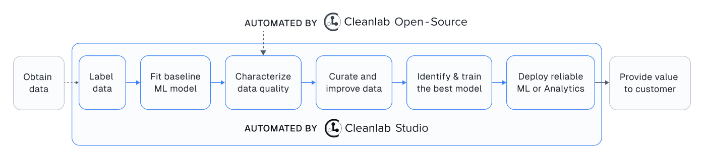
Introducing Cleanlab Studio
Features:
Automates cleanlab algorithms.
Uses AutoML & Foundation models.
Provides AI-suggested fixes.
Benefits:
100x faster data analysis.
10x more issue detection.
Automates labeling, ML deployment, and content moderation.
Adoption: Trusted by Google, Amazon, and numerous other industry leaders.
Try for Free: Boost data curation and productivity with Cleanlab Studio.
Notes:
But actually one more thing, Cleanlab Studio, the enterprise version of our powerful data curation tool.
Cleanlab Studio is packed with features designed to revolutionize your data curation process. While the open-source version takes care of a specific part of your model pipeline, Cleanlab Studio handles almost everything. So, if you're not a developer or if you're looking to streamline your workflow, Cleanlab Studio is your go-to solution.
It automates cleanlab algorithms, harnessing the power of cutting-edge techniques like AutoML and Foundation models. Plus, it offers AI-suggested fixes, making data issue resolution effortless.
But what sets Cleanlab Studio apart are the benefits it brings. Imagine analyzing your raw data in just one minute, without writing a single line of code or engaging in any ML work. That's the level of efficiency Cleanlab Studio delivers, allowing you to focus on the tasks that truly matter.
And when it comes to data quality, Cleanlab Studio is unparalleled. It detects and corrects ten times more types of issues using advanced AI, ensuring your datasets are of the highest quality.
But here's the exciting part. Cleanlab Studio isn't just another tool; it's trusted by industry giants like Google, Amazon, and many other leading companies.

Slide 6
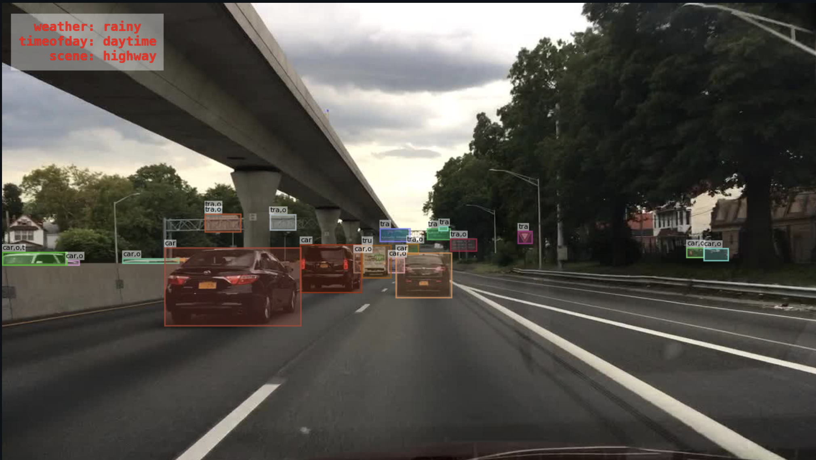
Object detection task involves:
Localization
classification
Multiple bounding box
Annotated with given class label
Predictions of locations and classes

Slide 7
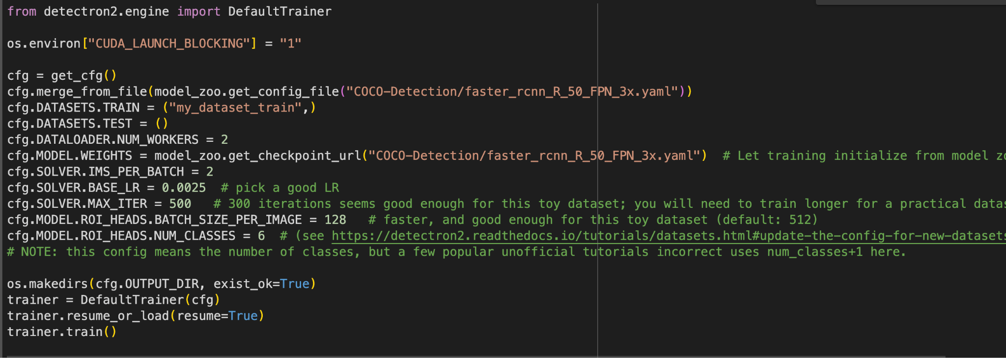
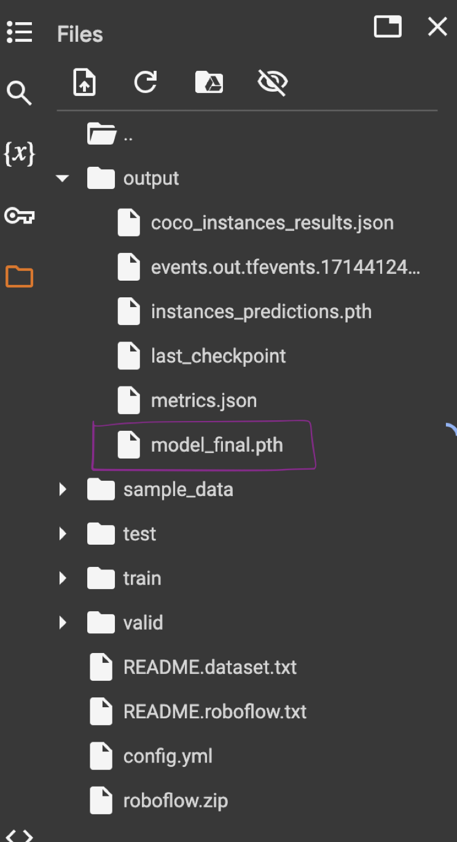
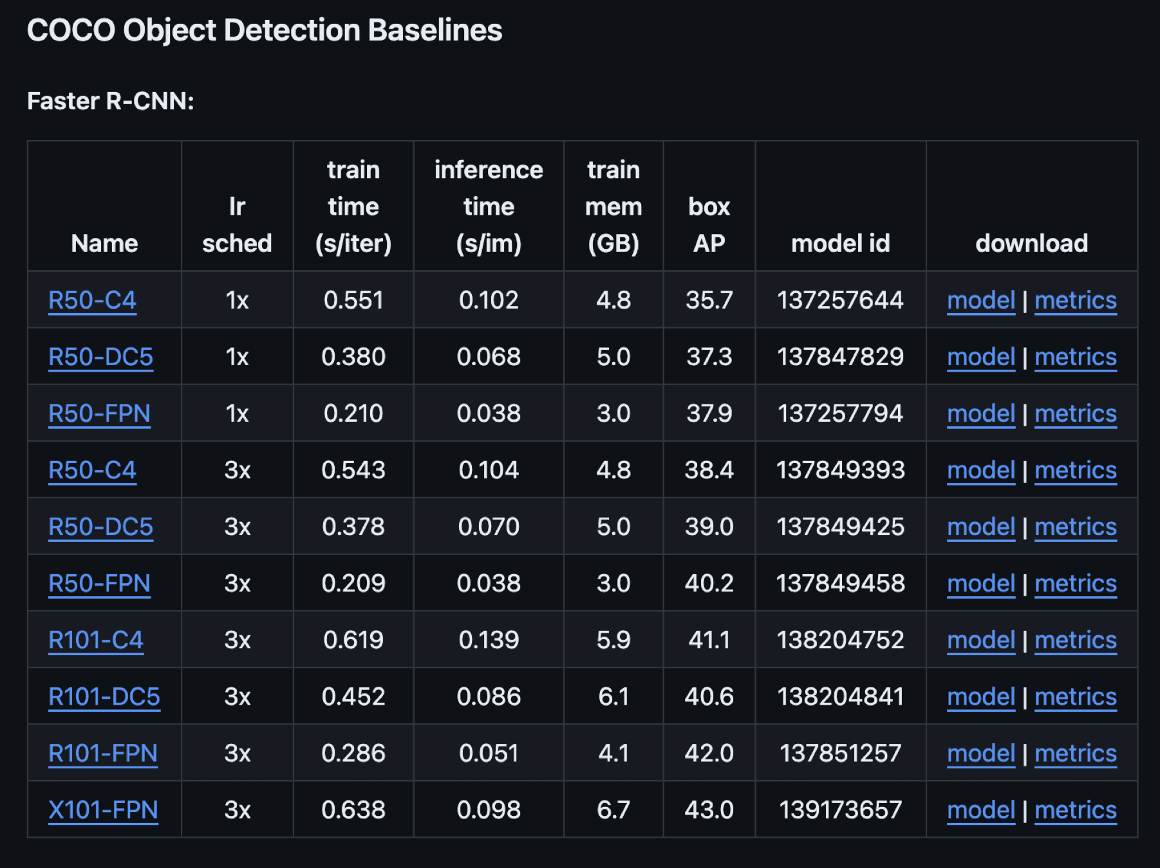
Object detection using detectron2
COCo OBject detection Baselines:
FaSter R-CNN
RetinaNet
RPN-fast R-cnn

Slide 8
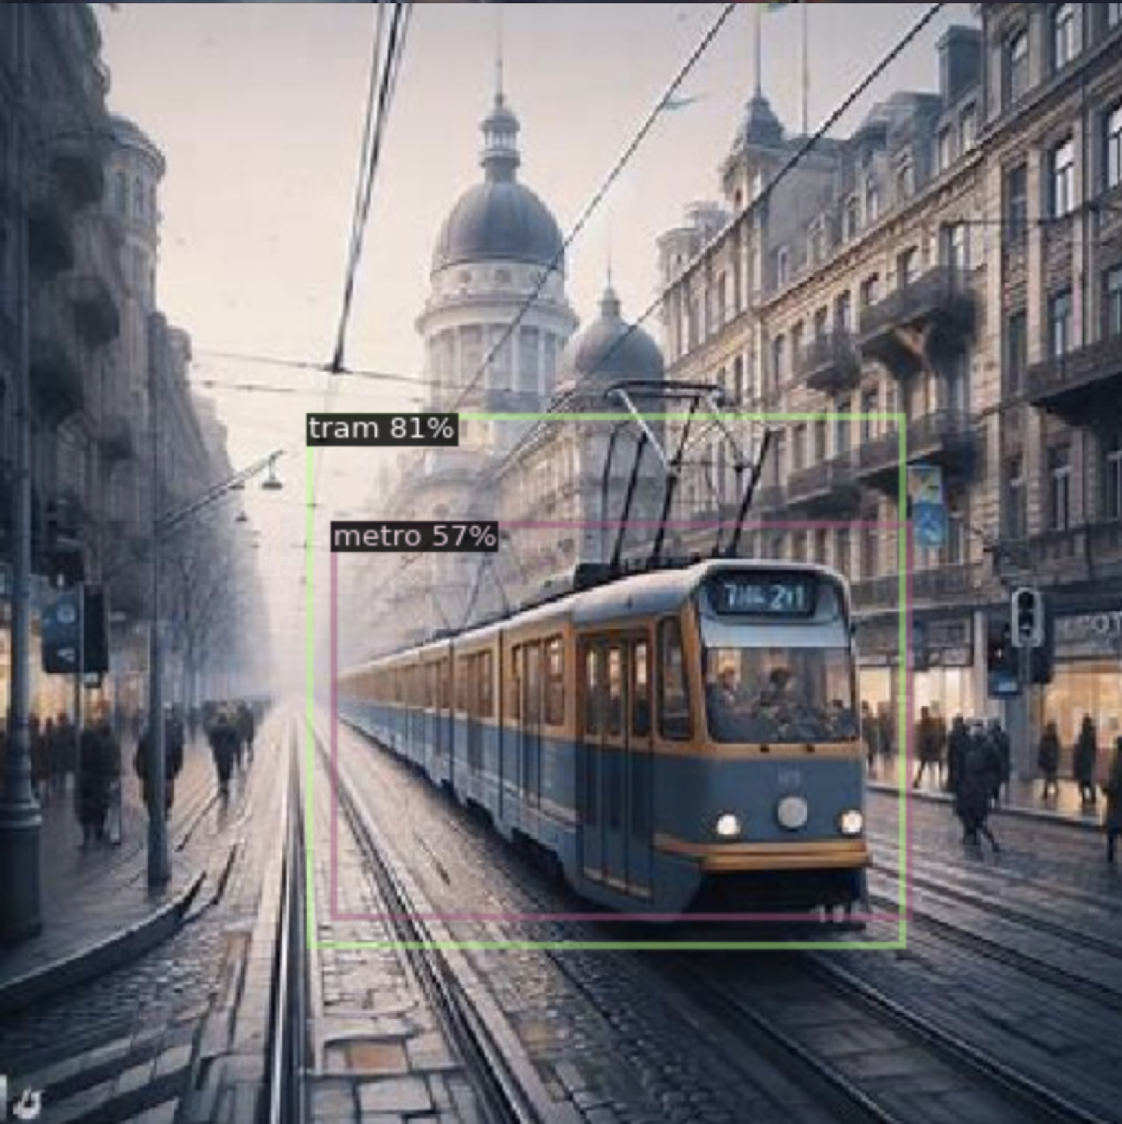

Slide 9
In cleanlab:
Score the images cleanlab.object_detection.rank.get_label_quality_scores
Estimate label issues cleanlab.object_detection.filter.find_label_issues
Review images and label cleanlab.object_detection.summary.visualize

Slide 10
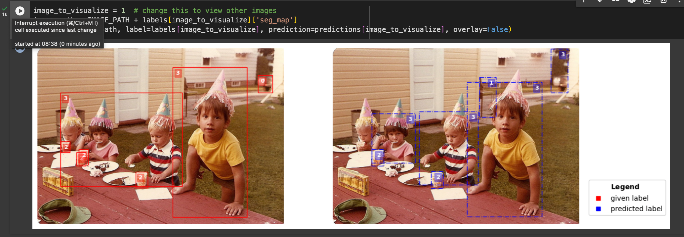

Slide 11
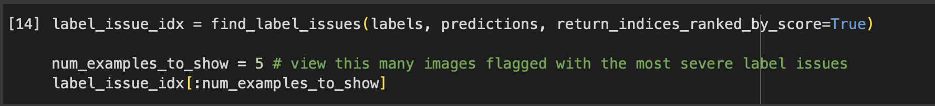

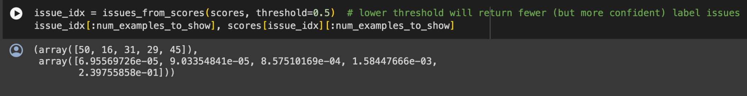
array([50, 16, 31, 29, 45])
array([0.97489622, 0.70610878, 0.98764951, 0.88899237, 0.99085805])

Slide 12
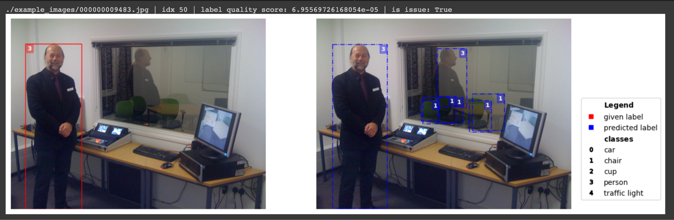

Slide 13
Summary
Thank you!
Notes:
After dedicating time to thorough research, meticulously examining the disparities among different versions, and delving into various cleanlab projects, it becomes evident that incorporating them could significantly augment the performance of our model within the data preparation and cleaning phase. Nonetheless, while this integration holds potential, it does not stand as the project's bedrock. Our central focus remains on constructing a DL model proficient in predicting or identifying labeled issues in images, constituting our primary objective.

